Slide 1
Frisbee Motion
Presentation by : Jonathan Riso and Charles Frederic Michel

Slide 2
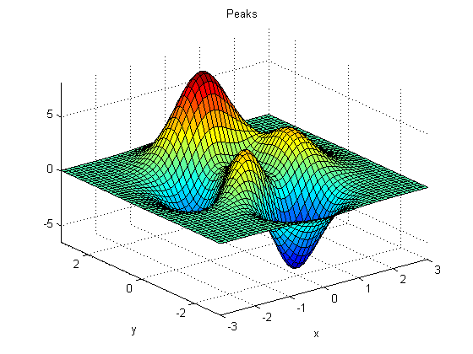
What is the question we want to answer?
Purpose
At which angle a frisbee should be thrown to reach maximum range?
Reason why we choose to make our Term Project on this subject
Notes:
We decided to do our project on this subject because we were interested into projectile’s motion and the motions of frisbee seemed to be to most interesting thing we could work on.
Even though, the motion of a frisbee doesn't sound like the most interesting thing you can learn about nor seems to be pretty difficult, it is not actually the case. Sometimes, the things that looks like to be the simplest turn out to be applying many different scientific concepts making it far from being simple. Indeed, an experimented frisbee player will have to take into account the spinning rate and the angle of attack of the frisbee, the direction of the wind and much more in order for the frisbee to reach a specific height, range or aloft for certain time. In fact, its trajectory is mainly the result of two physical concepts, aerodynamic lift and gyroscopic stability (Morrison 2005). The reason of the research we are conducting is to come up with a code that will answer an optimization problem related to this specific subject : At which angle a frisbee should be thrown to reach maximum range?

Slide 3
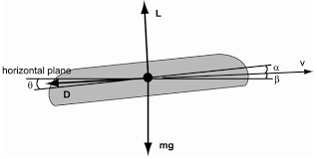
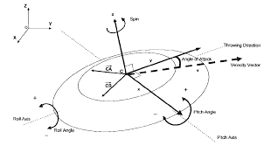
Theory
The Theory behind Frisbee flight
Aerodynamic Forces
Lift force - 90 degrees from the
Velocity vector
Drag force - 180 degrees from the
Velocity vector
Gravity - always directed to the ground
Gyroscopic Stability
Correlation between spin rate and the angular momentum
Notes:
Aerodynamic Forces
In order to study the behavior and to anticipate the trajectory of a frisbee flight, which is an aerodynamic object, we must understand and take into account the different forces and parameters which explains its motion. In fact, frisbees are not only influence by linear forces, but as well by rotational ones.
The magnitude of drag and lift, the two main aerodynamic forces that influence frisbee flight, can be derived from the Bernoulli Principle. This principle states that "a slow moving-moving fluid exerts more pressure than a fast-moving fluid" and explains how the flow of liquids or gases can create change in pressure but also how it alters objects' motion - particularly objects in flight.
The Reynolds number (Re) is an important dimensionless quantity in fluid mechanics used to help predict flow patterns in different fluid flow situations. The smaller the number, less turbulence an aerodynamic objects will face which could counter the motion of the object. This equation can be derived as willed depending on the situation (Flow in a pipe or Flow around airfoils) and depends on characteristics such as the density and the velocity of the fluid, the viscosity and more.
The coefficient for drag and lift + the equations for lift and drag for this kind of objects in such environment is found from this number
The coefficients depends on the angle of attack and are continuously changing and the equations on the coefficients and the velocity
Gyroscopic Stability
The rotation of the frisbee is essential to a stable and long trajectory. Indeed, the angular momentum that the frisbee experience when spinning enable the frisbee to be flip be easily flip over by the torque produced by lift and drag forces acting at the center of pressure which doesn't coincide with the COM (Morrison 2005). The components of the moment in the xyz axes are respectively called the roll, the pitch and the spin down moment. Moreover, they either influence the decreased of the spin rate due to fluid viscosity or result into damping. Even though, this concept and this rotational motion of the frisbee is essential to its unique trajectory, we won't take it into account in the calculations (Hummel 1997).In addition, the location of the COP is dependent on the angle of attack.

Slide 4
Computational method
Process we went through to find the best method to approach this problem of optimization
Methods :
Golden Section Search (GSS) from the Baywatch code
Euler's method from the Magnetic pendulum code
We modify the graphing method from the Zombie Apocalypse code
Created different methods to calculate the different forces, change in angle and accelerations in the x and the y direction
The constant were taken from the article :
The Aerodynamics of Frisbee Flight by Kathleen Baumback

Slide 5
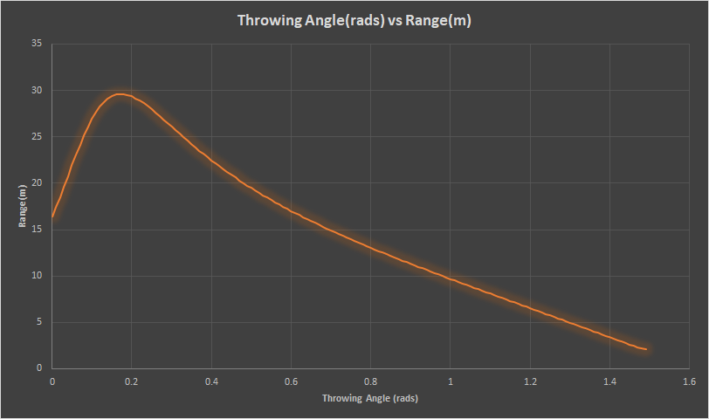
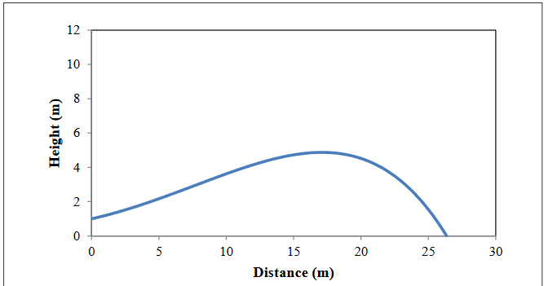
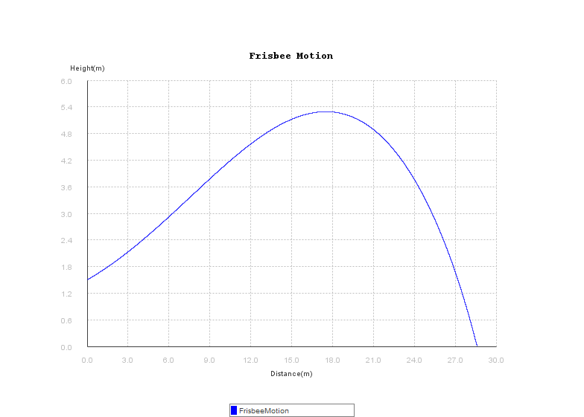
Results
The optimal angle to throw a frisbee is .1738 rads or 9.96°
The maximum range when thrown at 14 m/s is 28.4 m
Air time of 3.5 seconds
Percent error: Range = 8% | Angle = .42%
Steep increase followed by gradual decrease in range.
Graph from: Baumback, Kathleen. "The Aerodynamics of Frisbee Flight."
Notes:
Graph from : Baumback, Kathleen. "The Aerodynamics of Frisbee Flight." Undergraduate Journal of Mathematical Modeling: One + Two UJMM, Vol. 3: Issue 1, Article 19. 2010 https://scholarcommons.usf.edu/ujmm/vol3/iss1/31/?utm_source=scholarcommons.usf.edu%2Fujmm%2Fvol3%2Fiss1%2F31&utm_medium=PDF&utm_campaign=PDFCoverPages

Slide 6
Discussion
Potential sources of error
Different Programs to reproduce results.
Minor Deviations in constants
Use of different methods
What our Model does not take into account
Acceleration due to wind speed
the roll, the pitch and the spin down moment.
Wobble induced by thrower
Notes:
Why does it not take it into account?
Beyond the scope of this course and affects the motion very little.
Moreover, they either influence the decreased of the spin rate due to fluid viscosity or result into damping. Even though, this concept and this rotational motion of the frisbee is essential to its unique trajectory, we won't take it into account in the calculations (Hummel 1997).In addition, the location of the COP is dependent on the angle of attack.
*The wobble depends on Reynolds number - in fact this number depends on the velocity and viscocity of the fluid

Slide 7
Any questions?

Slide 8
Bibliography
Images:
http://www.frisbeesportverband.de/wp-content/uploads/2014/09/Bachelorthesis_Birger-Schultze.pdf
https://www.fiverr.com/g_abhiroop/implement-any-optimization-algorithm-in-matlab
https://i.gifer.com/MN7A.gif
Baumback, Kathleen. "The Aerodynamics of Frisbee Flight." Undergraduate Journal of Mathematical Modeling: One + Two UJMM, Vol. 3: Issue 1, Article 19. 2010 https://scholarcommons.usf.edu/ujmm/vol3/iss1/31/?utm_source=scholarcommons.usf.edu%2Fujmm%2Fvol3%2Fiss1%2F31&utm_medium=PDF&utm_campaign=PDFCoverPages

